Slide 1
Modular Construction
Presentation by: Scott McKown
Construction Codes and Licensing Division, DLI
www.dli.state.mn.us/Ccld.asp

Slide 2
What’s the difference?
Manufactured (mobile) Homes (HUD)
Prefabricated Buildings
Interstate Industrialized Modular Buildings
Closed Panel Construction

Slide 3
Factory Built Structures MN
What are factory built structures?
What is closed panel construction?
What is closed construction?
What codes or regulations are they constructed to?
Who inspects or certifies the units as meeting codes and regulations?
How do I become a manufacturer?

Slide 4
HUD Manufactured Homes
Manufactured Homes used to be called “mobile homes”. In 1976 a national program under the jurisdiction of HUD was created.
HUD Manufactured Homes are constructed to the Code of Federal Regulations: 24 (CFR) 3280 Construction and Safety Standards. The standards are preemptive and no state or locality may establish or enforce rules exceeding those construction standards.

Slide 5
Manufactured Home MN Rule 1350
MN Statute 327.31; subd. 6 contains definition of:
Manufactured Home – 8’ or more wide, 40’ or more length, when erected on site, is 320 or more square feet, chassis, dwelling…..
Manufactured Home Building Code – (HUD) manufactured homes constructed after June 14, 1976
A Manufactured Home is not a MODULAR BUILDING

Slide 6
HUD Manufactured Homes
HUD construction certification label.
One label on each section of home.
IPIA and label number

Slide 7
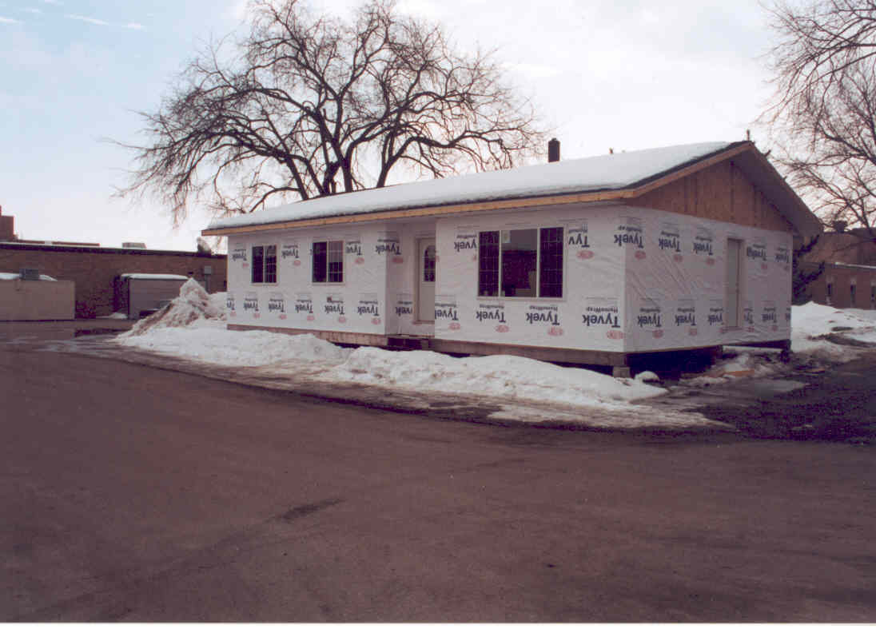
Prefabricated Buildings MN Rule 1360
MSBC 1360.0200 Subp. 15.
"Prefabricated Building" means any building or building module intended for use as an R-3, one- or two-family dwelling, or a U-1, accessory building, which is of closed construction……
These buildings are usually constructed by high schools, technical colleges and retail lumber yards. Limited to 3 per calendar year.

Slide 8
Prefabricated Buildings

Slide 9
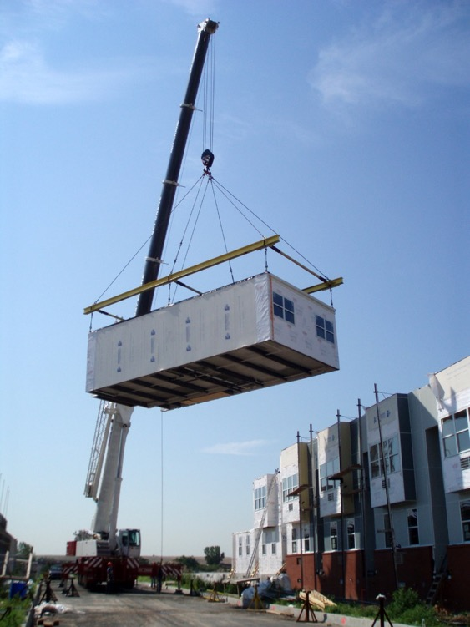
Industrialized Modular Buildings MN Rule 1361
Minnesota is a member of the Interstate Industrialized Building Commission. MN Statute 326B.194
Adopted Industrialized Building Commission, Model Rules and Regulations (MRR) for Industrialized/Modular Buildings. 1361.0300
Regulates Buildings and Building Components of closed construction.
Any building type or occupancy that complies with the building codes adopted by the receiving state.

Slide 10
Housing and Community Development Act of 1987
SEC. 572. STUDY OF VOLUNTARY STANDARDS FOR MODULAR HOMES. (a) IN GENERAL.—In order to facilitate the construction and delivery of housing, the National Institute of Building Sciences shall prepare and submit to the Congress not later than 6 months after the date of the enactment of this Act a report describing feasible alternative systems for implementing one or more voluntary preemptive national codes for modular housing, including the method for inspecting the structures to ensure compliance with the Reports. PUBLIC LAW 100-242—FEB. 5, 1988 101 STAT. 1951 selected code or set of codes. Such codes may be national model codes and shall provide for periodic upgrading through recognized model code development procedures and the development of modular housing standards for construction, design, and performance that ensure quality, durability, and safety and are in accordance with life-cycle cost-effective energy conservation standards established by the Secretary of Housing and Urban Development and designed to ensure the lowest total construction and operating costs over the estimated life of such housing. (b) DEFINITION.—For purposes of this section, the term "modular housing" means factory-built single-family and multifamily housing (including closed wall panelized housing) not subject to the requirements of the National Manufactured Housing Construction and Safety Standards Act of 1974

Slide 11
Interstate Industrialized Buildings Commission (IIBC)
The purpose of the compact is to promote and assure reciprocal recognition of states’ industrialized buildings programs through effective implementation of uniform rules and regulations. It streamlines regulations that govern industrialized (modular) buildings — from the design and manufacture to delivery and installation — and eliminates overlapping and costly reviews and inspections by multiple jurisdictions. The coordinating compact enables member states to improve efficiency and reduce costs by consolidating similar services as they continue to operate, staff and enforce their industrialized (modular) buildings programs. Improved compliance through uniform rules, regulations and procedures; better enforcement through sharing of information and findings; and reduced costs through elimination of redundant reviews and inspections are just some of the compact’s benefits.

Slide 12
Industrialized Modular Building
“Industrialized/Modular Building” means any building of closed construction; i.e., constructed in such a manner that concealed parts or processes of manufacture cannot be inspected at the site, without disassembly, damage, or destruction, and which is made or assembled in manufacturing facilities, off the building site, for installation, or assembly and installation, on the building site. "Industrialized/modular building“ includes, but is not limited to, modular housing which is factory-built single- family and multi-family housing (including closed wall panelized housing) and other modular, nonresidential buildings. "Industrialized/modular building" does not include any structure subject to the requirements of the National Manufactured Home Construction and Safety Standards Act of 1974.

Slide 13
Industrialized Modular Building

Slide 14
Industrialized Modular Building
CLOSED PANEL CONSTRUCTION
"Closed construction" means any building, building component, assembly, or system manufactured in such a manner that concealed parts or processes of manufacture cannot be inspected at the building site without disassembly, damage, or destruction.

Slide 15
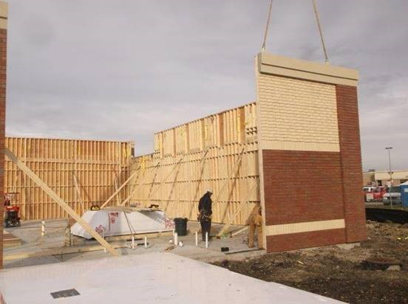
Industrialized Modular Building

Slide 16
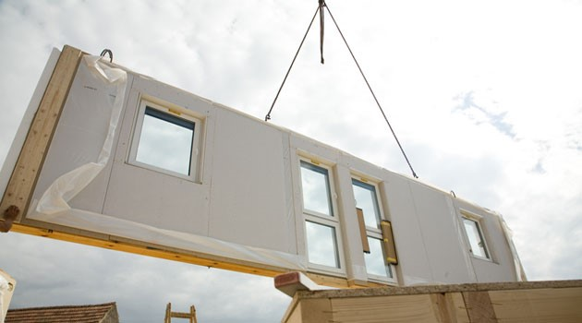
Industrialized Modular Building

Slide 17
Industrialized Modular Building
Which codes do Modular buildings have to comply with?
Industrialized buildings must comply with the adopted codes of the state in which they will be sited.
Who inspects and labels Modular Buildings and Panels?
A manufacturer must contract with a private or public designated agency to participate in the program

Slide 18
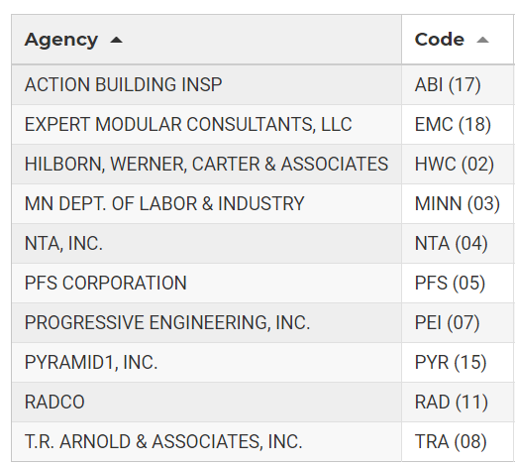
Industrialized Modular Buildings
Minnesota is the exclusive agency for manufacturers located in the state of Minnesota.
First two digits designate the 3rd party approval agency

Slide 19
Industrialized Modular Building
How do I get my manufacturer facility approved?
Submit an application and the required Compliance Assurance documents to the State
What Are Compliance Assurance Documents?
Building System Documents
Compliance Assurance Manual
On-site Installation instructions.

Slide 20
Industrialized Modular Building

Slide 21
Industrialized Modular Building
What is a Building System?
“Building System” means the method of constructing a type of industrialized/modular building or building component described by plans, specifications, and other documentation which together establish a set of limits meeting the building codes, standards, and other requirements of these regulations for that type of industrial/modular building or building component, which may include structural, electrical, mechanical, plumbing and fire protection systems and other systems affecting health and safety.

Slide 22
Industrialized Modular Building
Compliance Assurance Program Manual
Compliance Assurance Program means the policies and procedures which assure that industrial/modular buildings and building components, including their manufacture, storage, delivery, assembly, handling, and installation conform with these Model Rules and Regulations and Uniform Administrative Procedures.

Slide 23
Industrialized Modular Building

Slide 24
Industrialized Modular Building
On-Site Installation Instructions
The on-site installation instructions consist of specific installation procedures provided by the manufacturer, which specify the materials and procedures required to install the building in conformance with the code standards. Specific installation procedures by the manufacture shall include connection details, structural connections, required mechanical and/or utility systems and any special conditions affecting other structural elements. Installation means the process of affixing, or assembling and affixing, industrial/modular buildings or building components on the building site.

Slide 25
https://interstateibc.org/

Slide 26
https://www.dli.mn.gov/business/manufactured-structures/industrialized-and-modular-buildings

Slide 27
Questions?

