Slide 1
September 16, 2019

Slide 4
Supply Chain Control

Slide 5
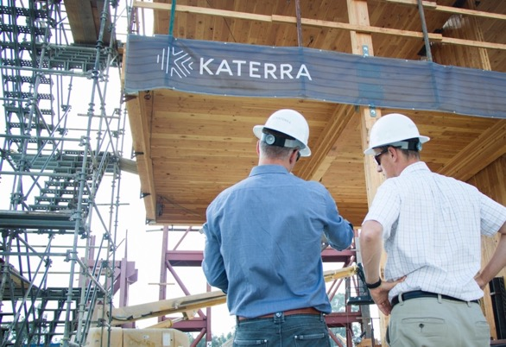

Slide 6
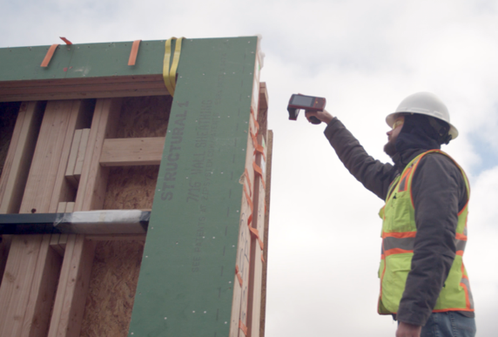
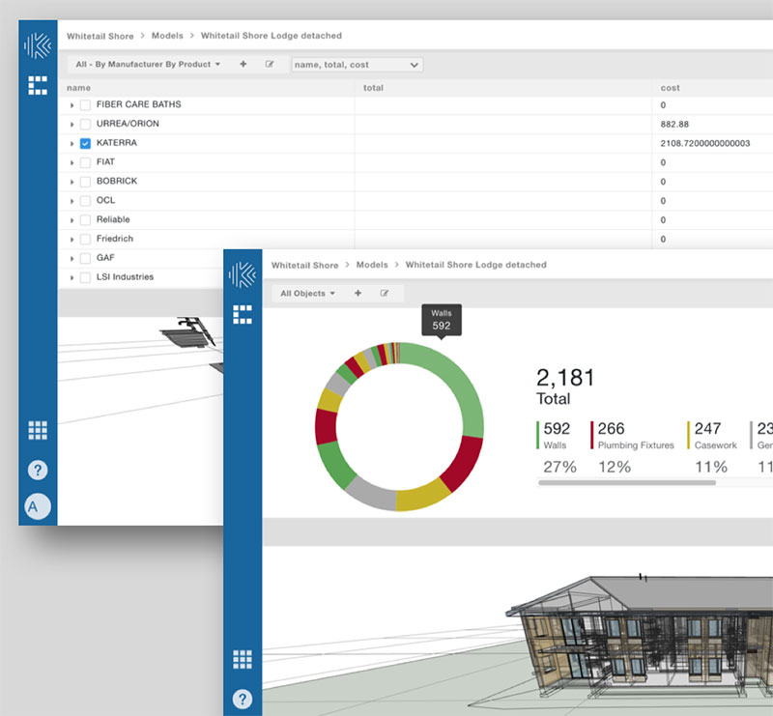
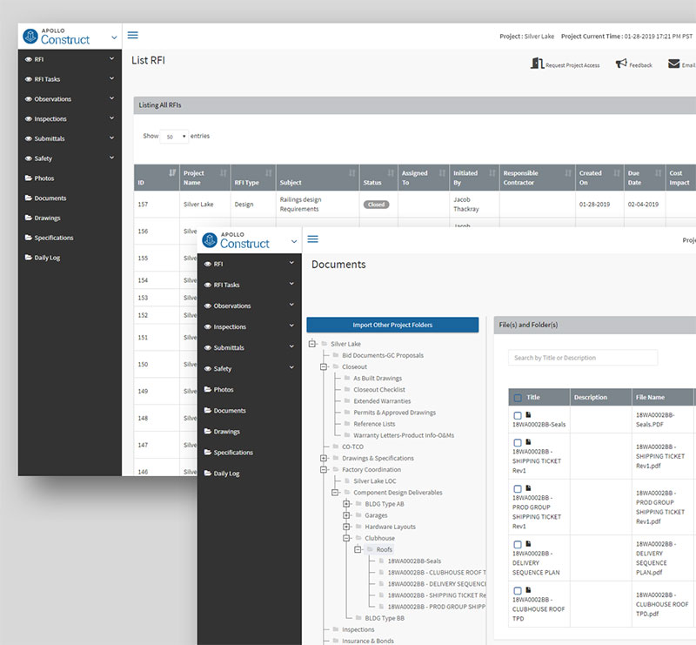
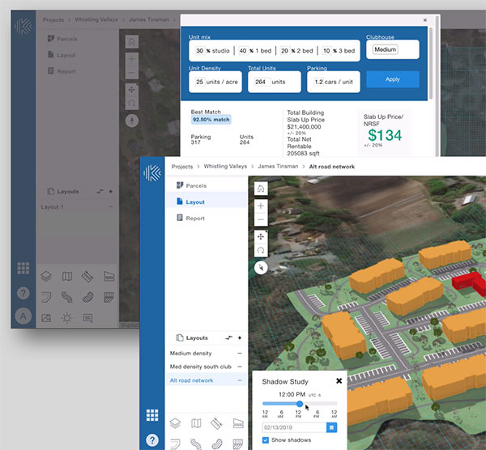

Slide 8
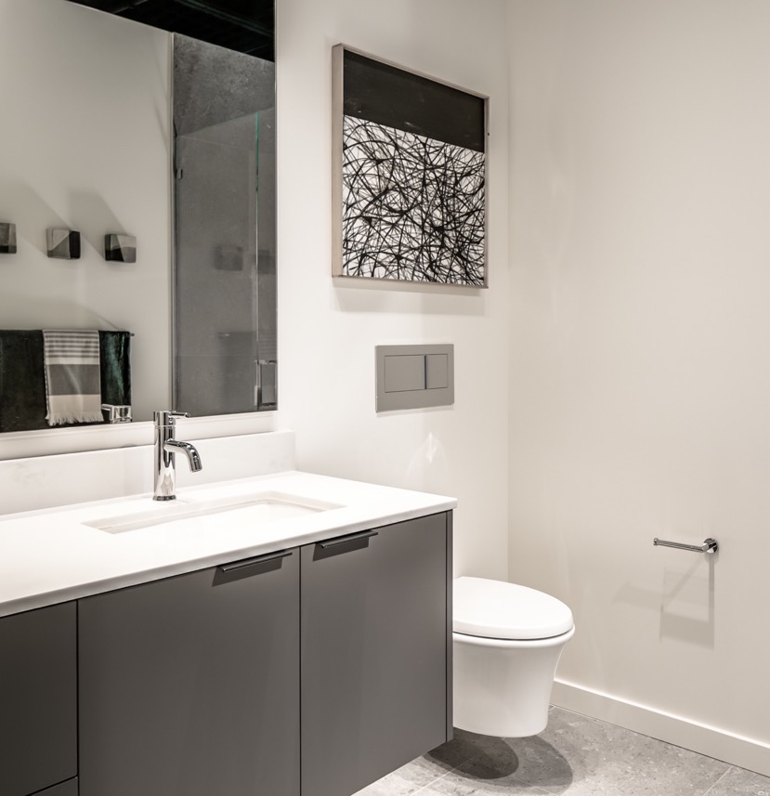

Slide 9
Status Quo
Architecture &
Engineering
Interior Design
Manufacturers
Retailers
Distributers
General Contractors
Subcontractors
Cost
Markup
Cost
Markup
Cost
Markup
Cost
Markup
The Katerra Way
Architecture &
Engineering
Interior Design
Katerra Manufacturing
Facilities
Katerra Materials from Global Supply Chain
On-Site Construction

Slide 11
Materials and Products
Mass Timber
Exterior & Interior Finishes
Structural Building Components
Kitchen & Bath
Commercial & Residential Building Materials

Slide 12
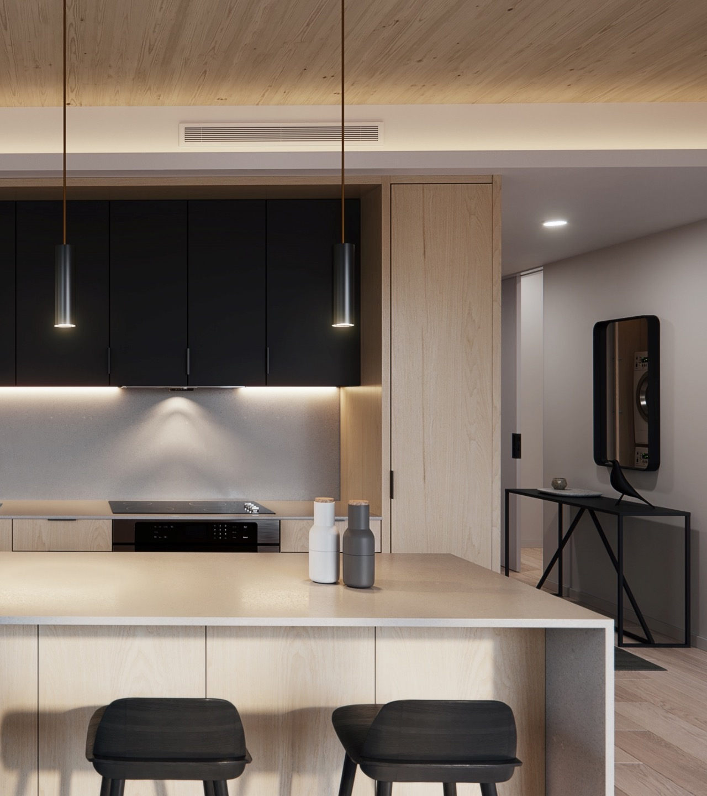

Slide 13
