Slide 1
Introduction:
Jason Landry
25 Years in the Engineering and Modular Industry Experience
11 years as Director of Engineering at Modular Manufacturer
Past 4-1/2 years as a Consultant for the Modular Industry
Expertise in the Design, Engineering, Inspection, and Overall Completion of Modular Buildings

Slide 2
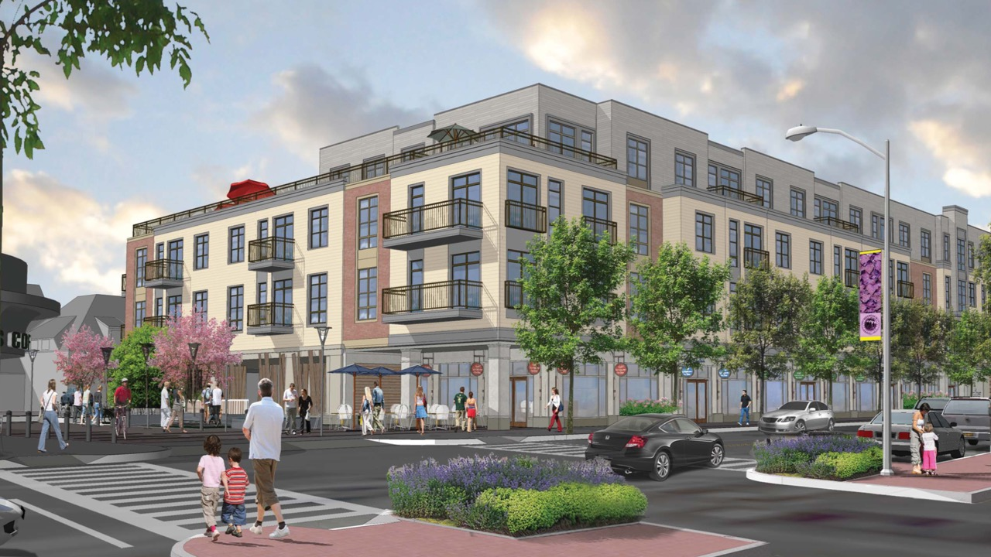
THE PROMISE AND IMPERATIVE OF MASS CUSTOMIZATION
CONSTRUCTION REVOLUTION SUMMIT
MINNEAPOLIS, MN
SEPTEMBER 16, 2019

Slide 3
HOW DO WE CREATE A REVOLUTION IN THE CONSTRUCTION INDUSTRY ?
MASS PRODUCTION AND CUSTOMIZATION

Slide 4
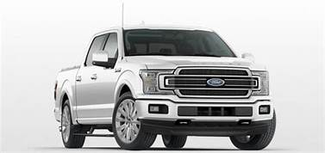
LET ME SHOW YOU MY FAVORITE EXAMPLE THAT DEMONSTRATES MASS PRODUCTION AND CUSTOMIZATION TO THE HIGHEST LEVEL
FORD F-150
BEST SELLING TRUCK IN THE UNITED STATES FOR 42 YEARS
BEST SELLING VEHICLE IN THE UNITED STATES FOR 33 YEARS

Slide 5
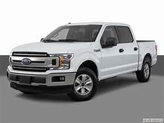
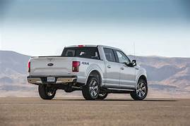
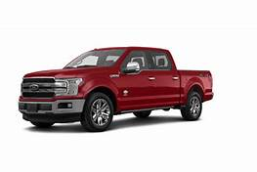
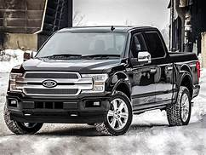
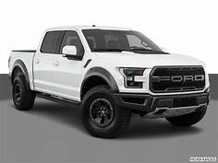
Why Is This A Great Example of Mass Production and Customization?
XL
XLT
LARIAT
KING RANCH
PLATNIUM
LIMITED
RAPTOR

Slide 6
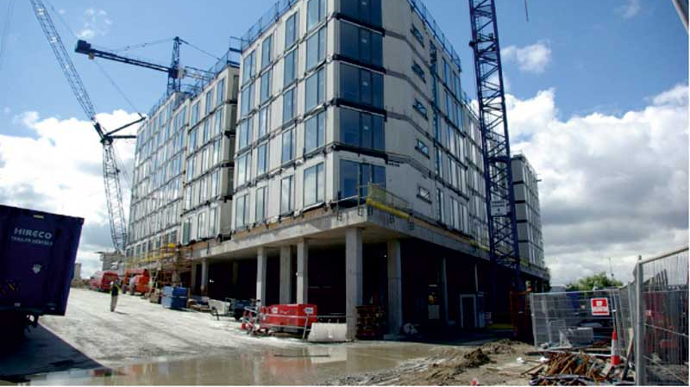
SO HOW DOES THE CONSTRUCTION INDUSTRY CREATE MASS PRODUCTION AND CUSTOMIZATION?

Slide 7
STANDARDIZATION
CUSTOMIZATION
EDUCATION
INNOVATION

Slide 8
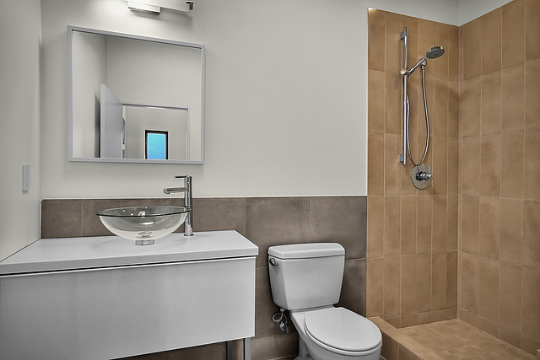
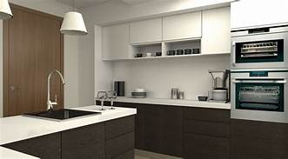
STANDARDIZATION
Design
Standard Kitchens
Standard Bathrooms
Standard MEP /utility closets
Engineering
Structural Designs
HVAC Systems
Details
Accessibility items
Fire rated assemblies
Cross sections
Products
Plumbing fixtures
Electrical Fixtures

Slide 9
CUSTOMIZATION
Options / Trim Packages
Affordable / Standard / Luxury
Technology Packages
Energy Packages
Exterior and common areas
Encourage the architect to focus on the exterior and the common spaces. These are the areas that are most visible to the public and the architect of record can focus on them. Let the MM focus on the unit layouts for they have built them many times.

Slide 10
EDUCATION
Developers
Design Professionals
Contractors /sub-contractors
Collaborative Learning
One approach I used to learn the most that I could was to ask the people the were finishing my designs…the factory workers in the MM factory or the sub-contractors on site. They were more than willing to give me constructive criticism and help me understand how to design better so that it was easier for them to construct.

Slide 11
INNOVATION
How to produce more product
How to develop new methods and materials
How does the construction industry embrace technology

Slide 12
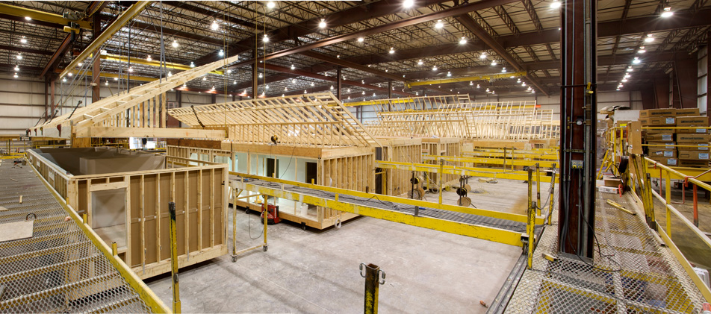
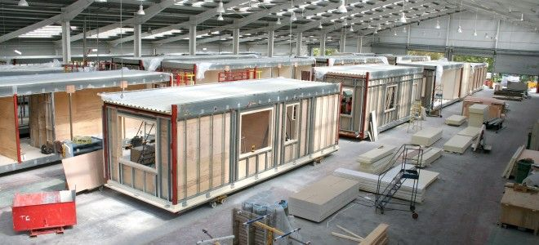
Why Does Modular Production Lend Itself To Mass Production & Customization ?

Slide 13
Modular Production and Mass Production and Customization:
Mass Production
Assembly Line Process
Standard Parameters – Box widths, lengths, heights, framing, MEP
Standard Materials
Customization
Trim levels – Affordable, Standard, Luxury
Option packages, Tech or “Green” packages
Ability to supply the client with any option they want (almost)– knowing that it comes with a cost premium

Slide 14
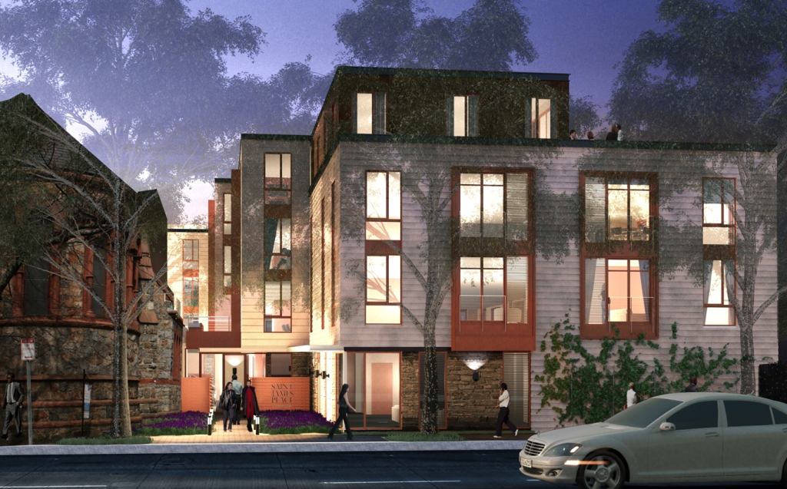
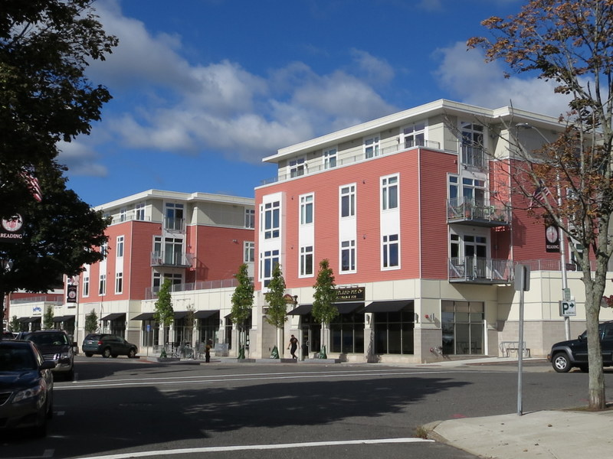
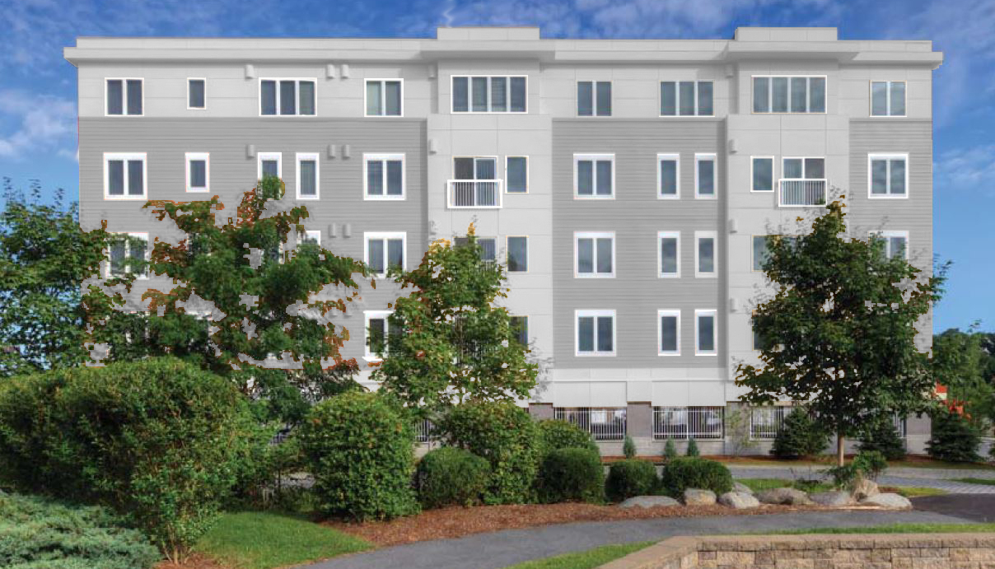
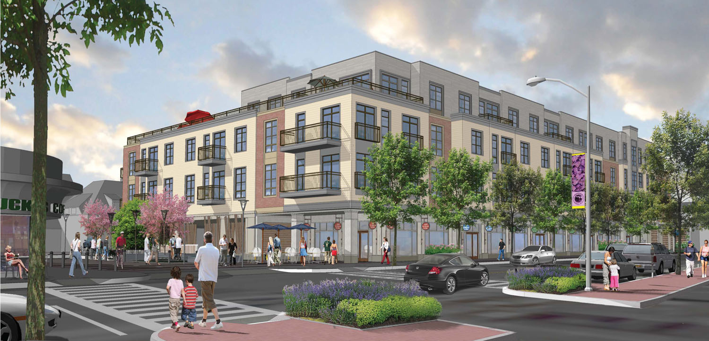
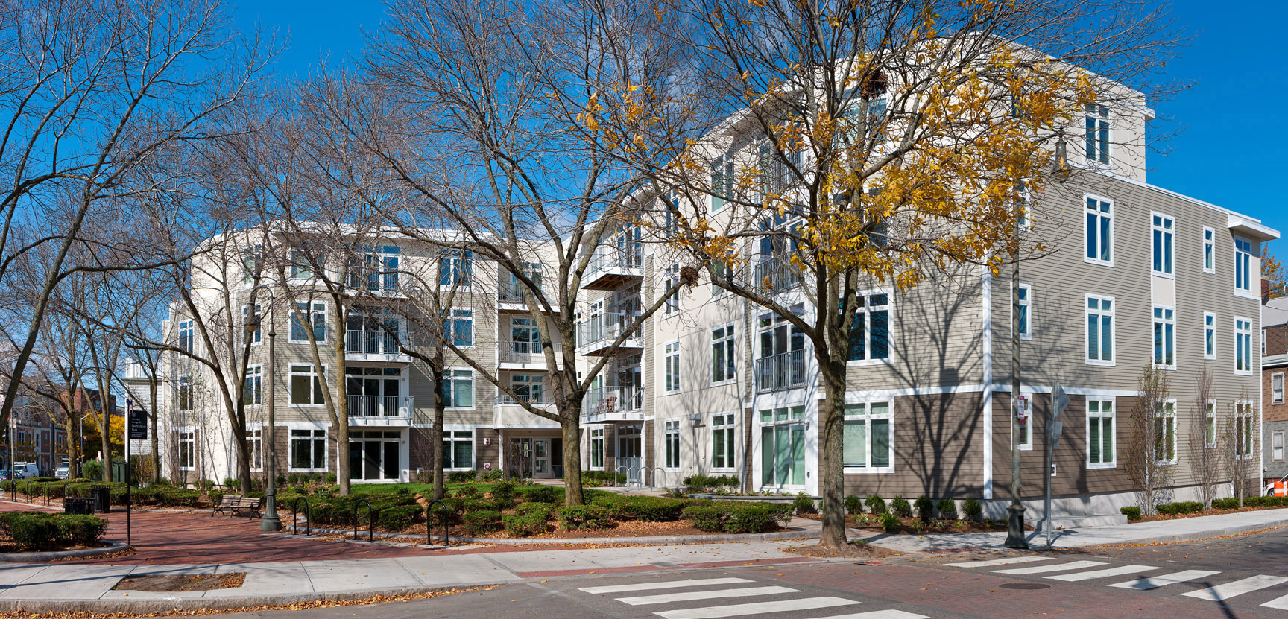
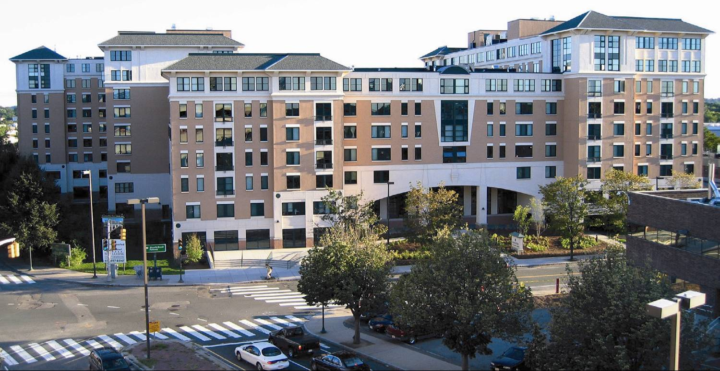
Standard Modular Design Elements – Custom Elements

Slide 15
Summary:
The construction industry NEEDS to implement the use of technology and mass production to become more efficient and productive
Labor shortages will drive this change
Education will help point us in the right direction
Technology will aid in the growth of the mass production

Slide 16
THANK YOU
FOR MORE INFORMATION
PLEASE CONTACT ME AT
JLANDRYCONSULTING@YAHOO.COM

