Slide 1
The Future of Offsite Construction
Construction Revolution Summit,
Minneapolis, MN
T.G. Jayanth
Sep.16, 2019
CONFIDENTIAL AND PROPRIETARY
Any use of this material without specific permission of McKinsey & Company is strictly prohibited

Slide 2
A quick word about McKinsey ……..
Unparalleled track record in capital projects….
… and we invest in research that’s on the cutting edge
Recent publications
#1
#1
28
Modular Construction: From projects to products
Jun ‘19
ranking by ALM - Vanguard of capital projects and infrastructure consulting practices
ranked private sector think tank by University of Pennsylvania think tank guide
years in business economic research, McKinsey Global Institute (MGI) was created in 1990
Housing Affordability: a Supply side tool-kit for cities
Oct ‘’17
1,880+
50-60%
Smart cities: Digital solutions for a more livable future
capital projects and infrastructure engagements in the last eight years
Boost in construction sector productivity possible through seven levers, as identified in MGI’s 2017 report Reinventing Construction: A Route to Higher Productivity
Jun‘19
Infrastructure and the Resilience Dividend
May ‘14
180
areas of cutting-edge expertise across 22 industry sectors and 12 functional areas
How the Houston Astros are winning through advanced analytics
Jun‘18

Slide 3
Contents
Macroeconomic trends impacting the construction industry
Insights from the McKinsey report on modular construction
A look at the future

Slide 4
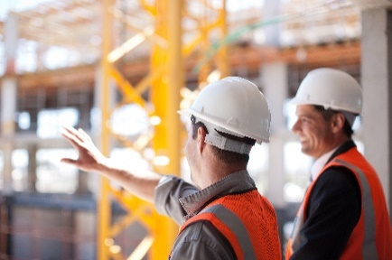
Long-term macroeconomic trends that impact construction
Key elements
Growth of Cities
Global shift of population towards cities: two-thirds by 2030
Shortage of housing, concurrent w/ labor shortage
In U.S., competition among cities for talent
Cities that offer jobs, QoL amenities, affordable housing will win
Critical need for Infrastructure
Aging / inadequate infrastructure, crumbling before our eyes
$5.5T additional investment needed globally 2016 – ’30
Power, roads, water need significant additional investment
Sustainability & resilience
Includes ending poverty, hunger, providing clean water, equal opportunity employment, .. (U.N. Sustainability Goals)
Material choices, Green Buildings
Resilience could become a key requirement
Extreme weather, cyber-threats, terrorism: codes & standards emerging

Slide 5
Contents
Macroeconomic trends impacting the construction industry
Insights from the McKinsey report on modular construction
A look at the future

Slide 6
Shortage of housing + shortage of labor = Opportunity for modular
Key market forces shifting value toward modular construction
Modular construction offers a potential solution for some of the industry’s problems
Dire shortage of affordable housing
High cost of construction labor – driven by shortage of labor: structural change
Continued low productivity of construction industry
Low baseline for modular in the U.S. <5% of construction market
1
Schedule improvement 20 – 50%
2
Labor cost savings 20 - 40% possible
Improved end product quality due to tighter tolerances and fewer errors
3
Long term sustainability and lower life-cycle costs due to higher energy efficiency, more efficient material usage (sustainability as marketing strategy - Lindbacks)
4
5
Ability to build in resilience and adapt to new building codes
SOURCE: Internal McKinsey research, Thomas Insights
Notes:
https://news.thomasnet.com/featured/exploring-the-increase-in-modular-construction-demand/

Slide 7
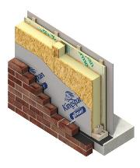
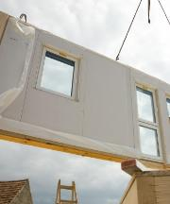
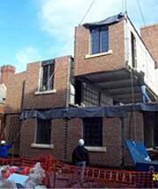
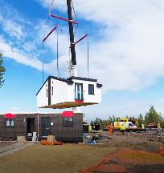
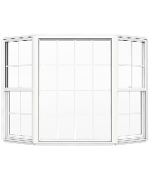
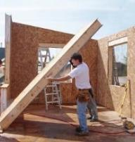
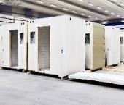
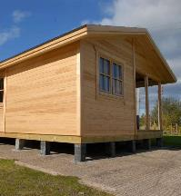
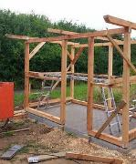
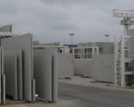
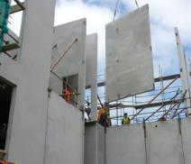
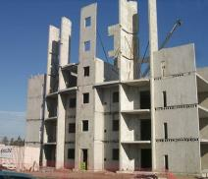
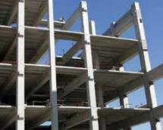
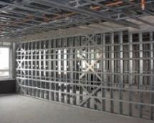
What do we mean by modular construction?
Flatpack
3D Volumetric
Increasing complexity
Fully serviced and finished single unit
Fully serviced and finished walls
Fully serviced and finished room
Fully serviced and finished house
Fully functional with complex fixtures
Transitional single unit
Pre-finished panel
Pre-finished room
Pre-finished house
Limited fixtures in one or more materials
Frames: Pre-cast concrete, steel, wood
Largely structural (single material)
Increasing
scale
Single discipline,
individual units
Panels
Volumetric units
Complete structures
SOURCE: Interviews, case studies, literature review

Slide 8
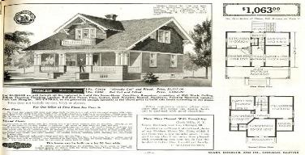
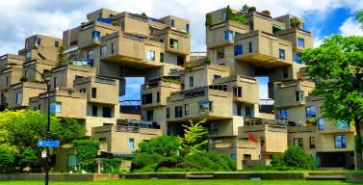
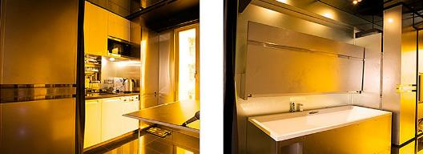
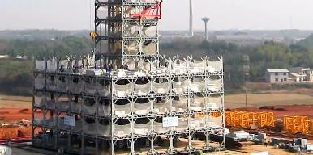
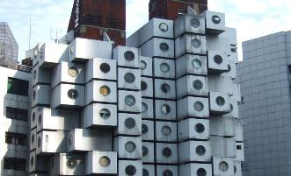
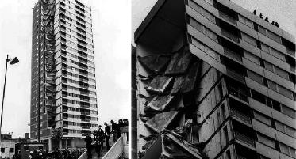
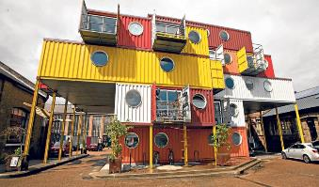
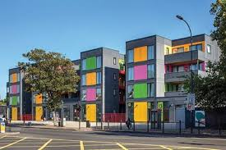
We have been here before...
1908 Emergence of the catalogue kit home
1960s –High architecture
90s-00s - Rise of the micro Apartment
2012 – High rise in China
1900
1950
2000
1950s – US Boom
1950-70s – Metabolism housing in Japan
1960-70s – UK ‘pre-fab’ boom
2000 – Container housing
Present day – Construction labour crunch
SOURCE: McKinsey analysis

Slide 9
Seven factors determine the attractiveness of a market for modular
Regulation
Supply
Key drivers
Demand
Regulatory
7
Access to materials
Quality perception
5
6
Supply chain and Logistics
Local site constraints
3
4
Consolidated and continuous demand volumes
Labour dynamics
1
2
SOURCE: Interviews, case studies, literature review

Slide 10
20-50% schedule compression can be achieved by using offsite construction of 3D volumetric modules
Example apartment project
Duration, months
1
2
3
4
5
6
7
8
9
10
11
12
13
14
15
16
17
18
19
20
21
22
23
24
Planning and design
Redesign and change orders are very rare in offsite construction
Foundations
Traditional construction
Onsite construction
Construction over-run¹
Design and planning
Extra upfront design needed for early projects but over-all design phase will shorten once designs are repeated
Offsite manufacturing begins in parallel with sub-structure
Enhanced productivity in factory conditions allows fast module build
Foundations
Offsite using 3D volumetric
Offsite manufacturing
Fast assembly due to lack of MEP and finishing personnel on site
Onsite installation
Initial assembly in parallel with manufacturing of later modules
20-50%
faster
1 Over-runs of 25% - 50% of projected construction duration are common
SOURCE: Interviews, case studies; McKinsey Global Institute

Slide 11
There is an opportunity for 20 percent savings – but at a risk of up to 10 percent cost increases if labor savings are outweighed by logistics or materials costs
Traditional construction cost
Observed range of offsite saving/cost
Traditional construction cost, ¹ % of total, and potential offsite savings/cost, percentage point shift
0
10
20
30
40
Planning
n/a
Design
0 to +2
Preconstruction phase
Site preliminaries
-2 to -5
Substructure
n/a
Materials
-10 to +15
Construction phase
On-site labour
-10 to -25
Off-site labour
+5 to +15
Logistics
+2 to +10
Redesign
-5 to -8
Financing
-1 to -5
Enablers of construction
Factory cost
+5 to +15
Total construction project cost, %
-20 to +10
0
20
40
60
80
100
1 Indicative breakdown: varies by project
SOURCE: US Federal Highway Administration; McKinsey Capital Projects and Infrastructure

Slide 12
Many countries exhibit conditions appropriate for growth in offsite construction, but of these most lack the supply infrastructure in place to deliver it
UK
Small number of large factories, causes high production costs
But due to high labour rates cost competitiveness is increasing
Currently, ~15,000 new homes per year are created using offsite
Leading players are Legal and General, Vision Modular and Ilke Homes
Supply: Construction labour rate Construction wage / national median wage
1.25
Australia
Construction labour and demand for housing are high, resulting in an ecosystem primed for offsite manufacture
Current use of offsite is still low at ~5% of new homes
Most offsite manufacture remains unsophisticated using manual production lines
Leading players are Hickory and LendLease
1.20
Canada
United Kingdom
Australia
1.15
Midwest US
1.10
West US
Japan
1.05
Northeast US
Sweden
Italy
Netherlands
Denmark
1.00
Belgium
South US
Ireland
West coast US
Generally, the ecosystem is fragmented and low-scale: ~200 low-capacity manufacturers
But on the west coast high and rising wage rates have driven a recent shift towards offsite
Reflected in major interest and investment in silicon-valley based start-ups e.g. Katerra and RAD Urban
Spain
France
Austria
Finland
0.95
Portugal
Singapore
Singapore
Singapore’s Housing Development Board (HDB) is building ~20-30k units/yr using offsite technology
Mandate that all housing projects on government land should use prefabricated, pre-finished volumetric construction
The main driver is speed of construction - initial pilot projects have not yielded lower costs of construction
0.90
Czech Republic
Slovak Republic
Norway
Switzerland
0.85
Germany
Poland
0.80
Hungary
0.75
0.70
0
0.1
0.2
0.3
0.4
0.5
0.6
0.7
0.8
0.9
1.0
1.1
1.2
1.3
1.4
1.5
1.6
1.7
1.8
1.9
2.0
2.1
2.2
Germany
Despite relatively low demand and labour driver imperatives, modular is gaining traction, led by high-end niche players e.g. Huf Haus
Leading residential players are now following e.g. Vonovia built a 3-storey 14-unit building at record low cost (30% savings) and in record time (3 months)
Demand: Housing projections 2017-2020 avg housing projection
as % of national housing stock
SOURCE: Euroconstruct; ILOSTAT; US Census Bureau; HIA Australia; ABS.Stat; Urban Redevelopment Authority; Natural Resources Canada; CMCH; OECD; Mitsui Fudosan; UK Ministry of Housing

Slide 13
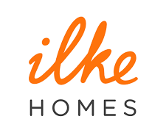
Modular construction makes up a small market share of residential construction in the U.S. & U.K.
Affordable housing
Single family homes
Multi-family buildings
Primary housing segment
Title
Current offsite share of housing, %
Primary frame material
Major players
Nordics
Timber
Japan
Steel
Germany
Timber
China
Concrete & steel
Australia
Timber & steel
UK
Concrete & steel
US
Timber & steel
1 Prefabricated housing share of all 1+2 family housing, note that in Sweden it has been reported that 84% of new homes are built using offsite methods | 2 Offsite construction share of all new housing | 3 In Germany 9% of new residential building permits are for prefabricated buildings, rising to ~20% of all 1+2 family homes | 4 Offsite construction share of all new housing
SOURCE: Prefab Housing (Matthew Aitchison); interviews; curbed.com; 5 in 5 Modular Growth Initiative (Ryan Smith); Roland Berger; Ministry of International Trade and Industry (Japan)

Slide 14
Contents
Macroeconomic trends impacting the construction industry
Insights from the McKinsey report on modular construction
A look at the future

Slide 15
All players need to prepare for shifts in value pools
ILLUSTRATIVE DRAFT
Development
Design & Engineering
General contractors
OEMs
Specialized trades
Operations & Maintenance
Example profit margin, %
>10
5-10
2-4
3-15
3-5
2-3
Buyers of more productized solutions
or
Owner-integrators of bespoke projects
Design libraries and engineering automation
Polarization of high value vs. repetitive work
Model could become obsolete if modules and better BIM models improve planning and lower risk
More specialization
Opportunity for package solutions and service offerings
but
Risk of commo-ditization
Partial displacement via modular
More efficient lifecycle management and use of data
Potential disruption
SOURCE: Expert interviews, client studies; McKinsey Global Institute analysis

Slide 16
From 2015 to ‘17, the modular market share as % of total construction increased by just 1%; however, this doubled total market revenues
Modular’s market share of total construction in North America, %, 2015-2017
5
4
Projected market share: 5% by 2020
3
2
2015
16
17
2020
Total Construction Starts: $221B (2017)
North American modular market revenue¹, $B, 2015-2017
+21%
4.0
3.5
The slower growth rate from 2016 to 2017 was largely driven by decreased growth in the residential market, following the completion of several large projects in 2016
3.0
+62%
2.5
2.0
2015
16
2017
1 Estimates made using average revenue collected from 45 PMC firms and total PMC firm count of 252
SOURCE: Modular Building Institute Permanent Modular Construction 2018 Report
Source: ...
Notes:
Methodology p. 23-24:
https://www.deluxemodular.com/hubfs/Third%20Party%20Press%20Downloads/MBI-2018PermanentModularConstructionReport.pdf

Slide 17
All of U.S. has a huge opportunity to leverage modular to address shortage of affordable housing
Key takeaways for Minnesota
Modular units in 2018
Dominant segments
Projected construction spending - 2019
Market opportunities
A major consideration for modular manufacturers to build a new factory is ‘continuity of demand’
MN, with its demand of ~35,000 units / yr over the next decade could be a very attractive market for manufacturers: opportunity to demonstrate the ~20%+ cost savings that have been elusive so far
Region 5 (which includes MN) produced less than 3,500 modular units in 2018 (includes schools, multi-family housing and offices)
A strategy that makes it attractive for the entire value-chain, including investors, developers, owners will go a long way towards solving Minnesota’s housing shortage
1095 units
2834 units
Office and education
50% in office/admin and education and accounts for 22% of all hospitality and residential
$$15B
$35B
Multi-family market expected to be 30%, education 25%
1567 units
3461 units
Multi-family, hotels, education, offices
Education, multi-family, offices
Education, offices, multi-family
$14B
$22B
3000 units
4200 units
Multi-family market expected to be 25% of total
Multi-family market accounts for 40% Remaining in education, office, healthcare, and hotel
Office, education, multi-family
Hospitality and apartments
$32B
$43B
Multi-family market accounts for 25%. Office and admin follow
Multi-family $14B in ‘20, Historically strong in education market. CA dominating market.
3828 units
6263 units
Office and education (no multi-family)
Multi-family just starting to grow
$40B
$58B
New factory opening to serve multi-family
Multi-family, educational, office and retail.
Total modular units in 2018: 26,269 (+12%)
SOURCE: Modular Building Institute Permanent Modular Construction 2019 Report, Offsite Architecture – Constructing the Future

Slide 18
Contact information
McKinsey & Company
Houston
T.G. Jayanth
Expert – Capital Projects
(630) 696 2179
TG_Jayanth@mckinsey.com
Linkedin:
Linkedin.com/in/tjayanth
@McKinsey_CPI
Latest insights:
https://www.mckinsey.com/industries/capital-projects-and-infrastructure/our-insights.

