Slide 1


Slide 2
Build 300,000 new homes by 2030, across all types, prices, and locations to stabilize prices and meet demand

Slide 3








Since 2000, housing costs have outpaced real wages in Minnesota
For Renters
For Homeowners
Household Income -1%
Household Income +2%
Median Rent Costs +13%
Median Rent Costs +33%

Slide 4
Moderate income households are caught in these trends in growing numbers
Largest cost burden increases have been for households with incomes between $35-75k
% of tenant households that are cost burden over time by income bracket
2005
2009
2013
+2x
2017
+3x
<$20K
$20-35K
$35-50K
$50-75K
>$75K

Slide 5
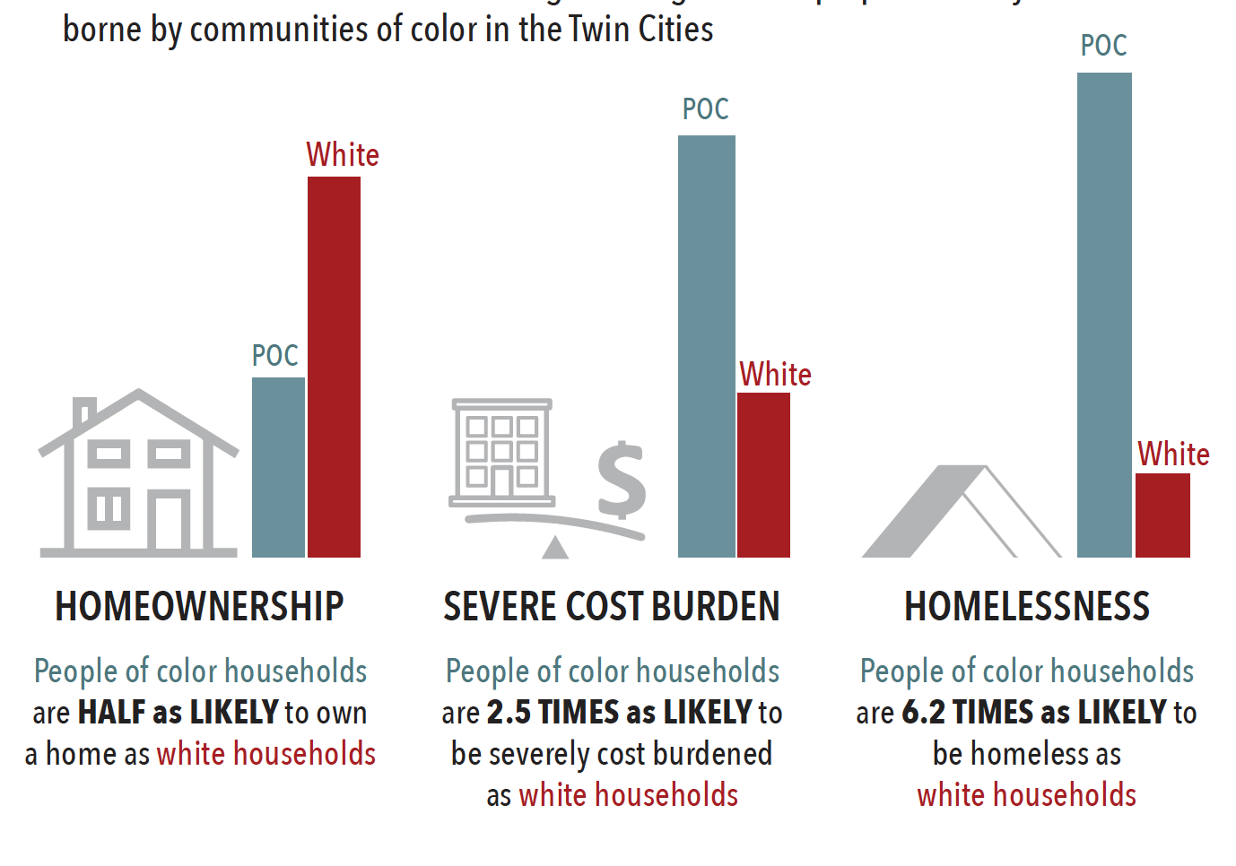
System strains exacerbate racial disparities in housing, caused by discrimination and past and present structural racism
Homeownership
Severe cost burden
Homelessness
People of color households are half as likely to own a home as white households
People of color households are 2.5X as likely to be severely cost burdened as white households
People of color households are 6.2X as likely to be homeless as white households

Slide 6
We have large production gaps for low- and moderate-income rental homes
Rental markets construction is particularly uneven
Rental production vs. needed distribution by household income
Excess of units based on need
Current annual production
Deﬁcit of units based on need
Needed distribution
4,650
-550
-2,400
-1,700
<$25,000
$25,001-$49,999
$50,00-$72,000
>$72,000
SOURCE: Minnesota Housing analysis (data from HUD, Minnesota State Demographer’s Office, Met Council)

Slide 7
Minnesota is still working to overcome the housing shortage drive by the recession
Housing permits in Minnesota
Annual, single and multi-family private units
Multi-family units
Single-family
50k+ shortage
1988
1992
1996
2000
2004
2008
2012
2016
2018

Slide 8






Housing affordability is critical to our economic future and shared prosperity
$3.2 billion in new investment and
26% reduction in child poverty through increased rental assistance
30,000 jobs for every 10,000 new homes
+1 year more curriculum covered in schools with stable student populations, where learning isn’t disrupted by frequent moves
+$10,000 increase in annual household wealth through homeownership
55% cost savings
from enabling seniors to age
in place with modest rehab compared to skilled
nursing facilities
Cost of housing is often the
#1 criteria when considering relocating for work

Slide 9
Thank you!

