Slide 1


Slide 2

St. Michael Mixed-Use Development

Slide 3











Regional Modular Builders
DETROIT LAKES, MN
REDWOOD FALLS, MN
KINGSFORD, MI
MONTEVIDEO, MN
STRATFORD, WI
OWATONNA, MN
RAPID CITY, SD
MARSHFIELD, WI
WATERTOWN, SD
CHICAGO, IL

Slide 4
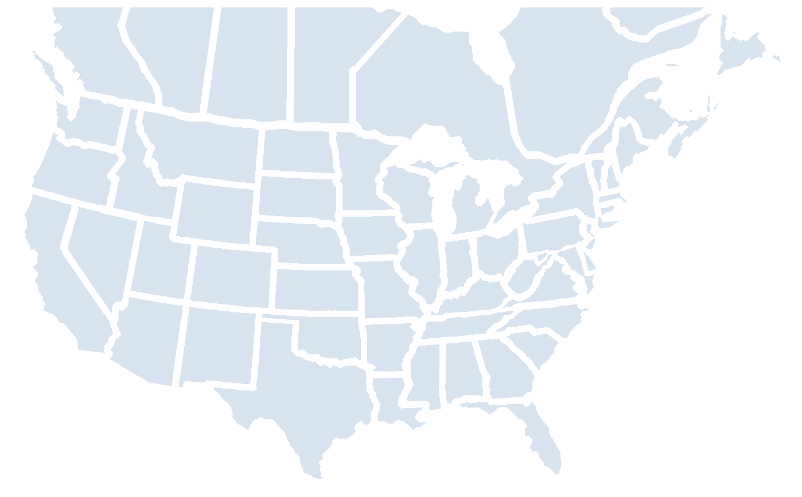






Large Scale, Commercial Modular Builders
AGASSIZ, BC / PENTICTON, BC
BERWICK, PA
BOISE, ID
Owatonna, MN
POTTSTOWN, PA
SEATTLE, WA
LATHROP, CA
BROOKLYN, NY
SAN FRANCISCO, CA
Chicago, NY
LEGEND
BIRMINGHAM, AL
(Zekelman Industries)
Steel
AUSTIN, TX
(Zekelman Industries)
Wood

Slide 5




Why Modular?
SPEED
COST
30-50% time savings compared to traditional stick-built
10-20% typical cost savings along with more predictable and certain costs
QUALITY
SUSTAINABLE
Built to tighter tolerances inside a climate-controlled environment with no exposure to outside elements
Less than 5% waste compared to 15% in typical stick-built construction

Slide 6
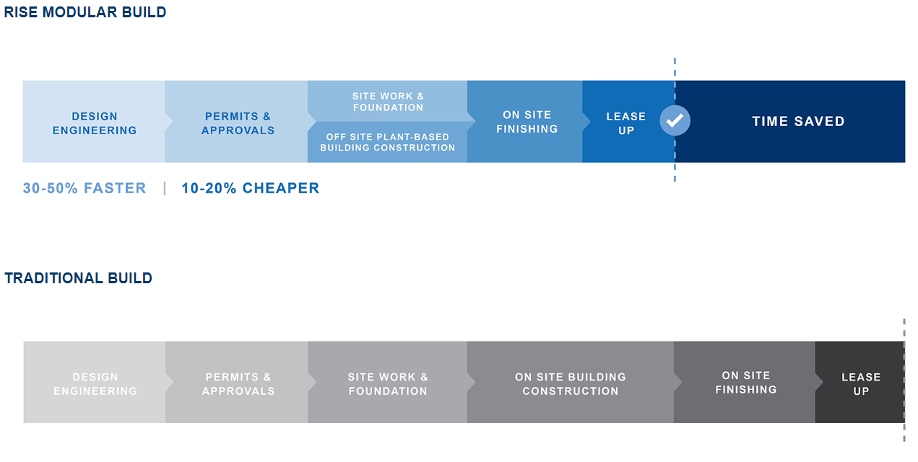
Why Modular?

Slide 7
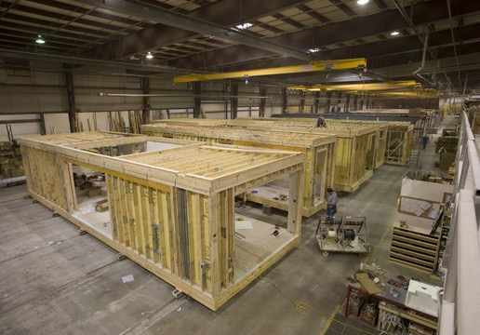
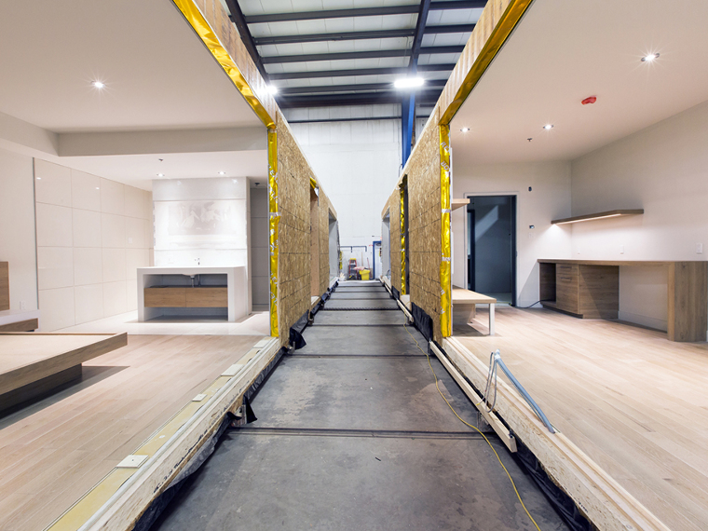
Why Modular?
Source: Triumph Modular
Source: RCM Modular Solutions Group

Slide 8
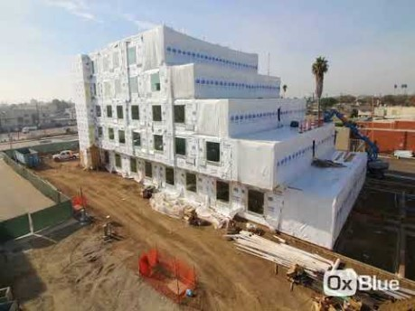
Why Modular?
Proset Modular - Courtyard / Town Place Suites, Hawthorne, CA Time Lapse

Slide 9
Why Wood?
85%+
Percentage of projects in our target market that are built with wood construction
61,358
Number of wood constructed units that came online in our target market in 2018

Slide 10
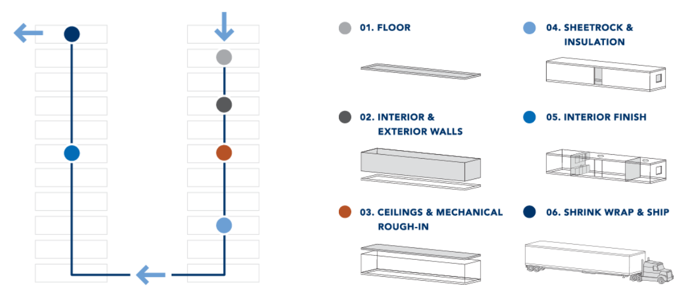
Manufacturing Process
*Owatonna plant currently under contract for end of September close

Slide 11
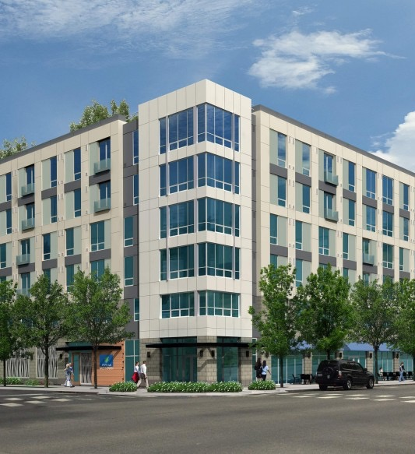
Target Markets
Multifamily
  Market Rate
  Workforce Housing
  Affordable Housing
Hospitality
Senior Housing
Student Housing
Multifamily Executive
“Modular Grows as Conventional Building Costs Climb”

Slide 12
Target Geography

Slide 13
Phase II

Slide 14
Phase III

Slide 15
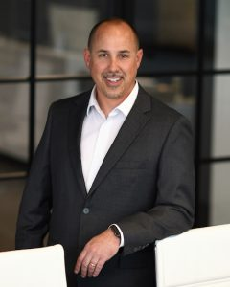
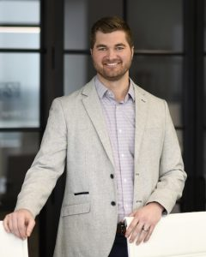
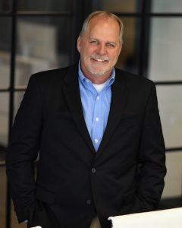
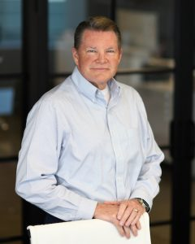
Key Management
Jason Jendrysik
Vice President of Operations
Eric Whittaker
Vice President of Finance and Business Development
David Thompson
Vice President of Construction
Wes Carter
Vice President of Strategy
Full management team has 110+ years of combined modular experience

